Slide 1
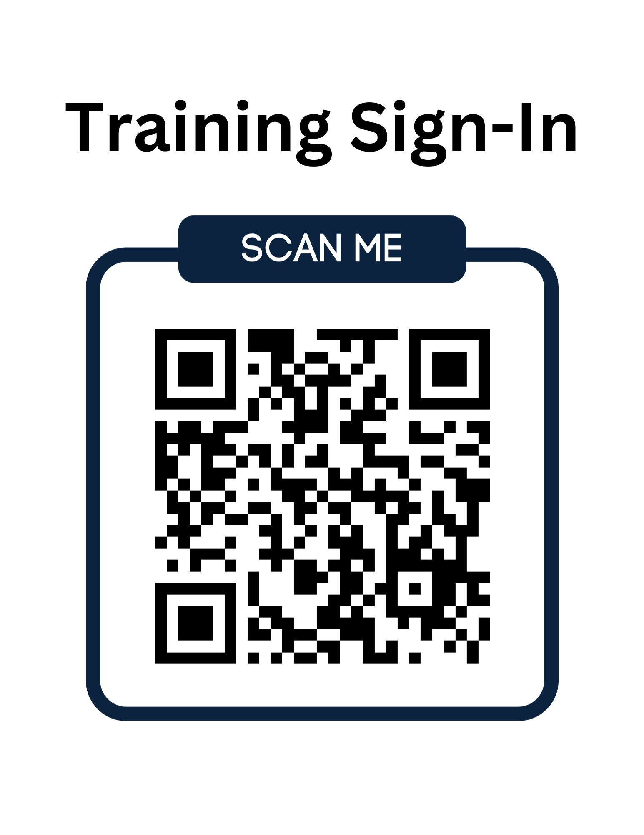

Slide 2

Title VI
Civil Rights Act of 1964
Annual Training
Notes:
The City of Bismarck Human Resources Department created this PowerPoint training to fulfill our annual training requirements.

Slide 3

Title VI Training Outline
What is Federal Financial (FFA)?
Title VI
ADA – Americans With Disabilities Act
What is Discrimination?
Limited English Proficiency (LEP)
Filing a Compliant
Notes:
Be sure you sign in today using the QR code or laptop.
The training sessions will be recorded and made available to departments and employees through the Know B4 system will track your completion of these videos.

Slide 4
Federal Financial Assistance (FFA) Requirement
What does Federal Financial Assistance (FFA) provide for us?
Grants and direct funding
Grants or donations of federal property
Equipment & training
Detail of federal personnel
Sale, lease, permission to use federal property
Notes:
Talking points - You may ask where do we get grants and direct funding?

Slide 5
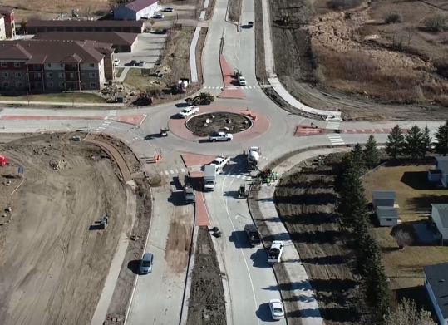
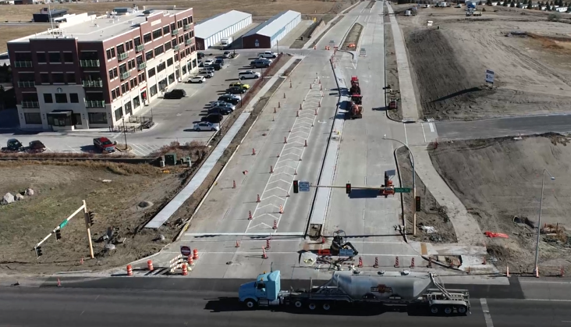
Pictures of the 43rd Avenue Project From State Street to N 26th Street
Notes:
One example was given by Gabe Schell, City Engineer, who stated that “Being a Title VI-compliant organization allows us to receive direct federal funding from the Federal Highways Administration (FHWA) and construct arterial roadways in advance of the federal allotment. The City makes the payments to the contractor as work progresses and FHWA reimburses the City when the funds are available. This advanced construction allows the City more control and flexibility when programming these types of projects. This process was used on the 43rd Avenue project from N Washington St to State Street in 2020, the 43rd Avenue project from State Street to N 26th Street in 2022”.

Slide 6
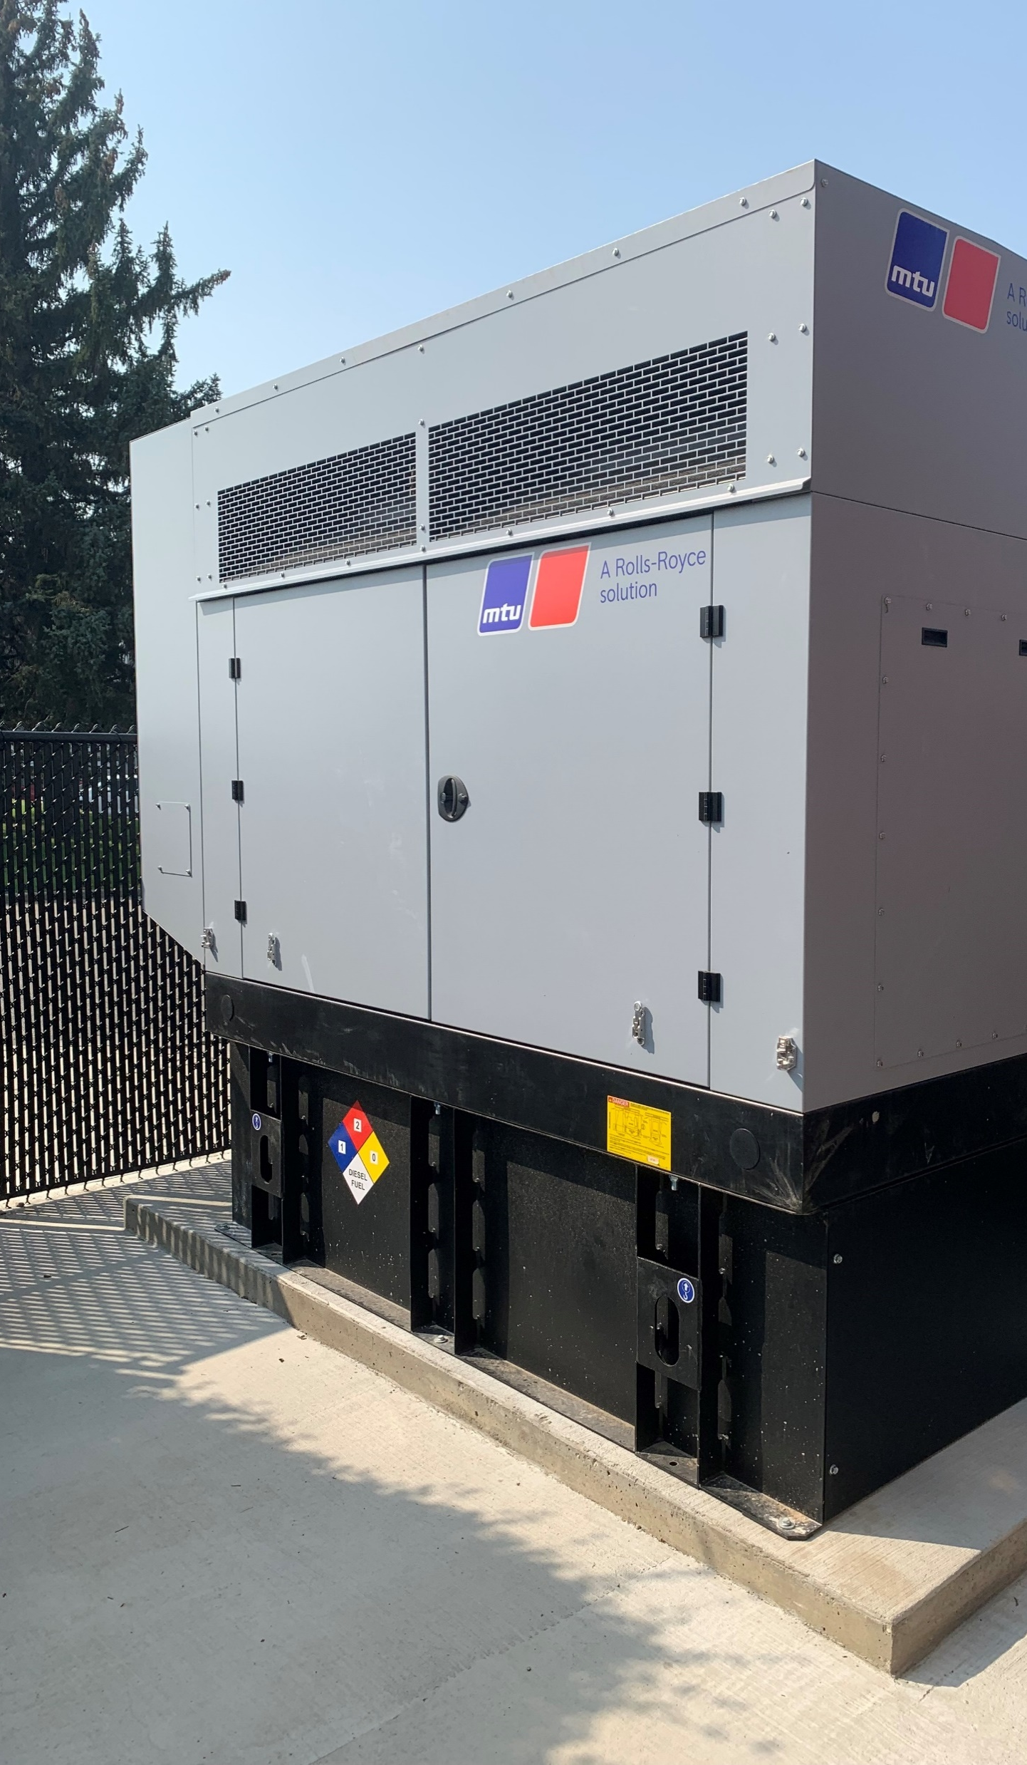
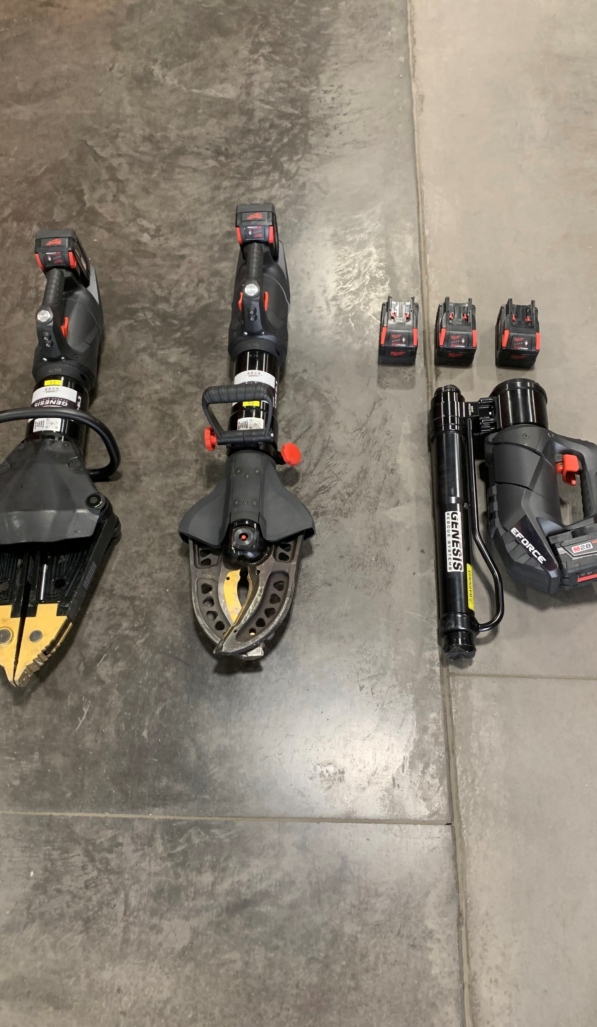
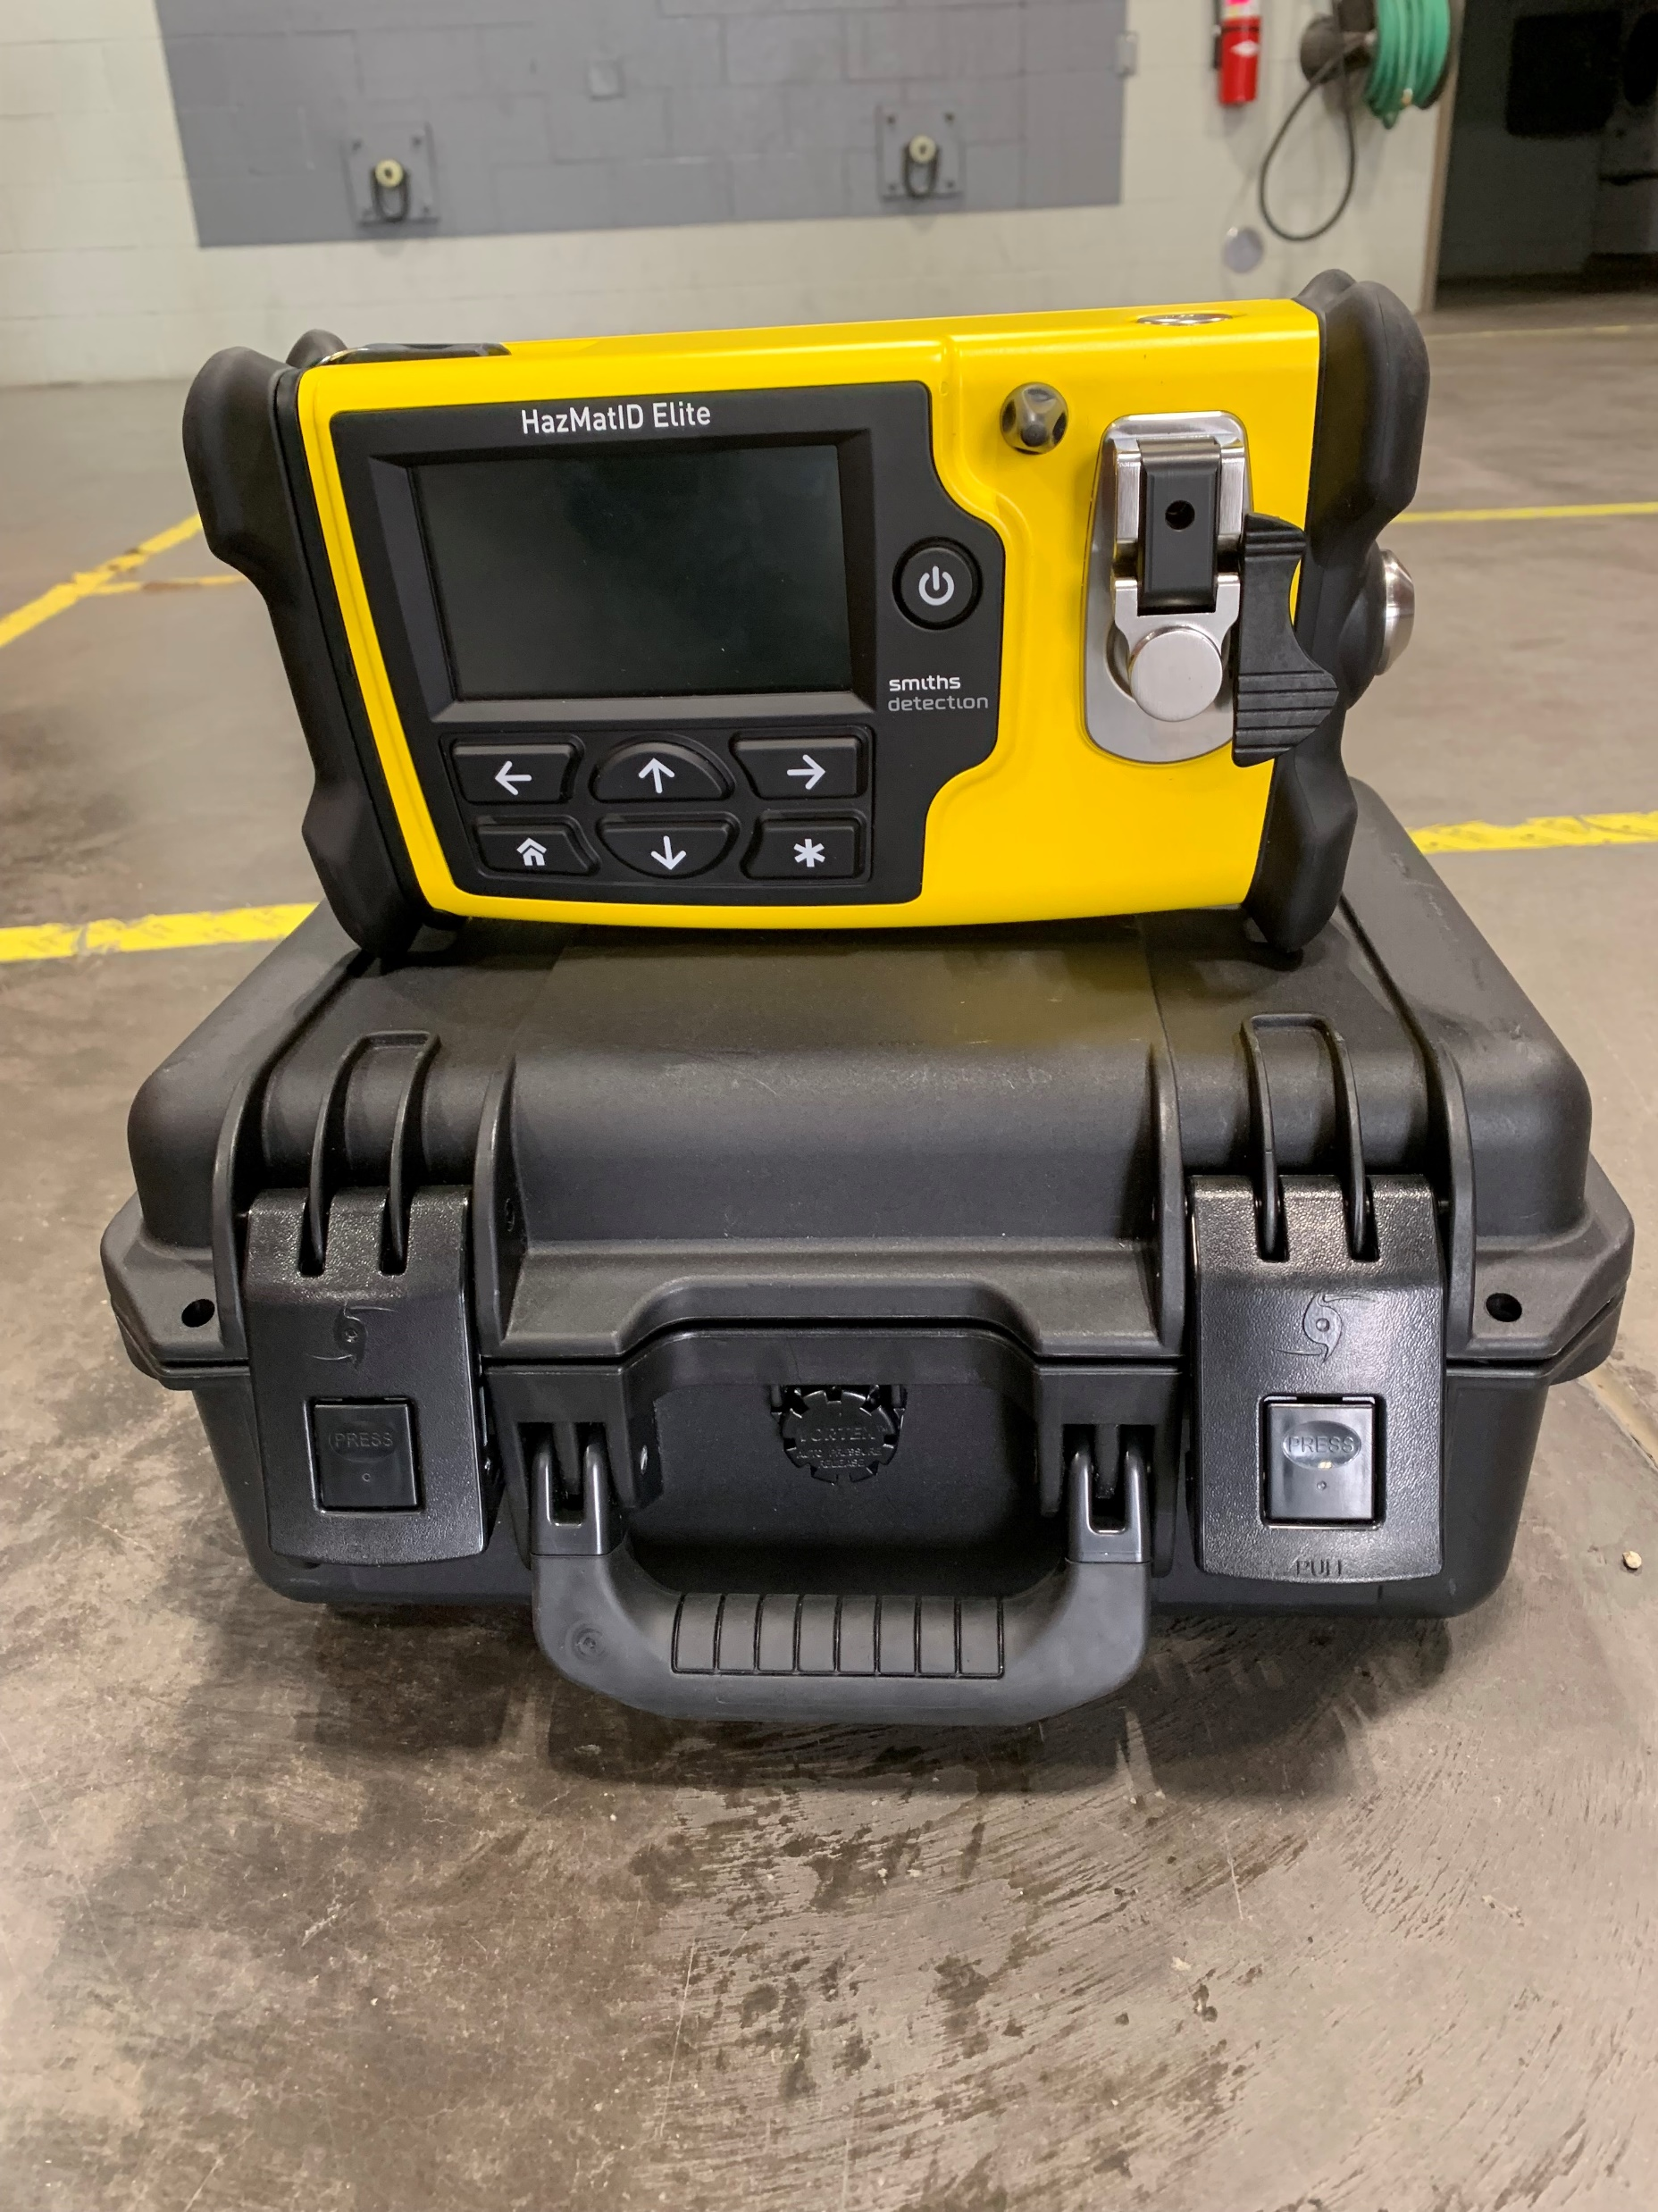
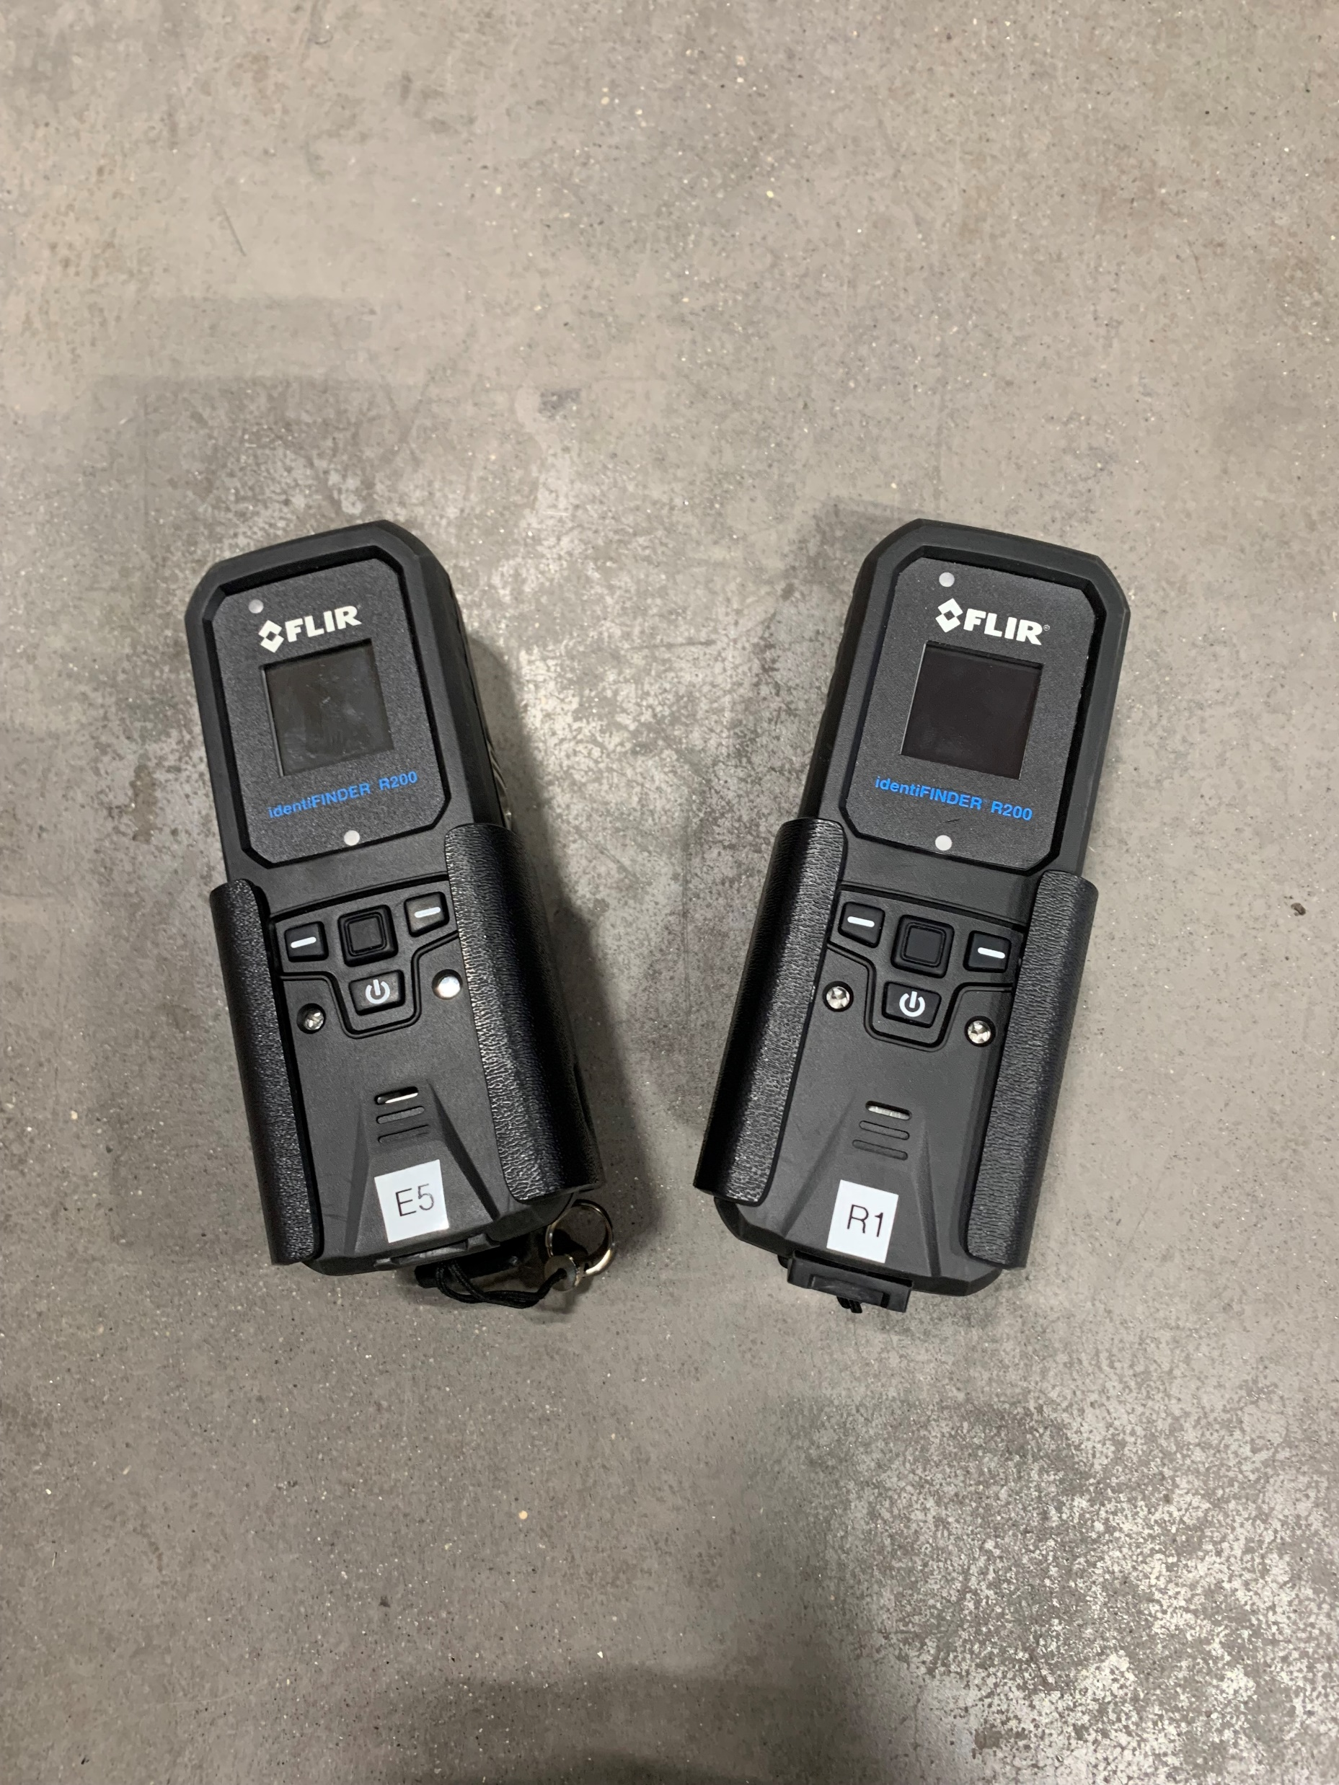
Equipment purchased by the Bismarck Fire Department using Federal funded monies.
Notes:
Another example of Federal funding includes monies for equipment for the Bismarck Fire Department. Through the help of Federal funding, they were able to purchase a generator for Station 1 which ensures continued performance even in the event of a power outage; Ergonomic Extrication Equipment, a HazMat ID Equipment, and Radiation Detectors, which helps the Fire Department can do its job in a safer way.

Slide 7
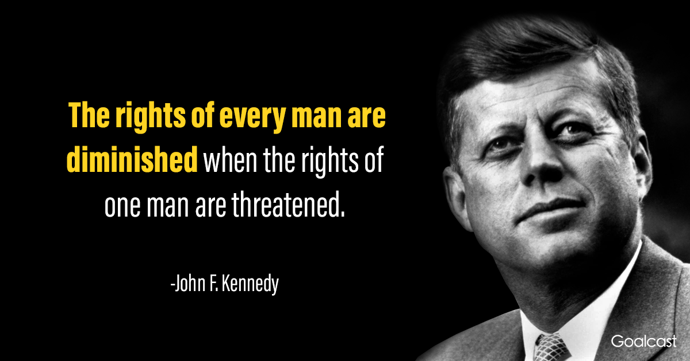
Title Vl
T42 U.S.C. S 2000d et seq., was enacted as part of the landmark Civil Rights Act of 1964.
No person in the United States shall, on the grounds of race, color, or national origin, be excluded from participation in, be denied the benefits of, or be subjected to discrimination under any program or activity receiving Federal Financial Assistance (FAA).
Notes:
Compliance with Title VI includes:
Appoint Title VI Coordinator – Leanne Schmidt, HR Director
Conduct annual employee Title VI Training - training is mandatory, it’s important to remember the purpose is about serving all of our community members.
Maintain and post Title VI Plan and Policy Statement – website, public entrances, and employee breakroom/areas. **Plan was reviewed & updated as needed based on federal agency review – April & September 2023. Workgroup worked to create a template.
Include Title VI Assurances in all contracts
Cover the connection of:
Bismarck City Title VI Plan –MPO – Title VI Plan
Bisman Transit – Title VI plan

Slide 8
Other Non-discriminatory statutes falling under the umbrella of Title VI, include:
Federal-Aid Highway Act of 1973 (SEX)
Age Discrimination Act of 1975 (AGE)
Rehabilitation Act of 1973/ADA of 1990 (DISABILITY)
Notes:
What Title VI really means is to ensure:
Accessibility to Public Meetings and Hearings
Overcoming Language Barriers
Overcoming physical Barriers
Being Provided the Same Services and Benefits regardless of the Challenges of providing them

Slide 9
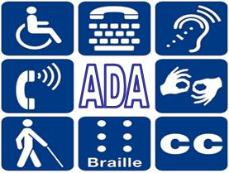
Americans with Disabilities Act (ADA)
The ADA prohibits discrimination against people with disabilities in several areas including employment, transportation, public accommodations, communications and access to state and local government programs and services.
https://youtu.be/iG3pQp6HoQM
Notes:
City of Bismarck has Title VI plan and related information can be found on the bismarcknd.gov/1413/Title VI and on HR Department SharePoint (replacing intranet).
Watch a short video.

Slide 10
In accordance with ADA, entities must ensure access to all individuals
Meeting is at accessible locations
  The City of Bismarck commission meetings are held in the Tom Baker Room which has elevator access for all individuals
Interpretive services provided for public access
  Propio Interpretive Services can be used for any individuals for which English is not their first language

Slide 11
Examples of Discriminatory Practices Not Tolerated
Denying an individual any service, financial aid, or benefit
Providing a different service, aid or benefit, or providing them in a manner different than they are provided to others
Segregating or treating individuals separately in any manner related to receiving programs, services, or benefits
National Origin/Limited English Proficient (LEP) Discrimination
Retaliation
Notes:
Retaliation occurs when a recipient or another person intimidates, threatens, coerces, or discriminates against any individual for the purpose of interfering with any right or privilege secured by Title VI, or because a person made a complaint, testified, assisted, or participated in any manor in an investigation or proceeding under Title VI.

Slide 12

Limited English Proficiency (LEP)
English is not their primary language
Limited ability to read, speak and/or write English
https://www.youtube.com/watch?v=yGvfEFue3hc
Notes:
Propio is City of Bismarck interpretive service provider
Insert propio information from flyer
Farren sent department codes/IDs but can resend them if needed
Watch short video.

Slide 13

The City of Bismarck utilizes Propio Language Services for any interpreter services needed. Propio offers over 300 Remote Interpreting Languages and can provide services via telephone, the Propio One app, or their website.
Use the “Point to Your Language” poster to help you identify which language is needed.
Telephone Instructions:
Dial 800-514-9237
Use City of Bismarck Access Code
Provide your first name and your department specific code
Propio ONE App Instructions:
Open the app via tablet or cell phone
Enter user code - nloMyk
Select Language
Propio ONE Website Instructions:
Open Propio ONE via web browser
Enter user code - nloMyk
Select Language
Click audio or video icon

Slide 14
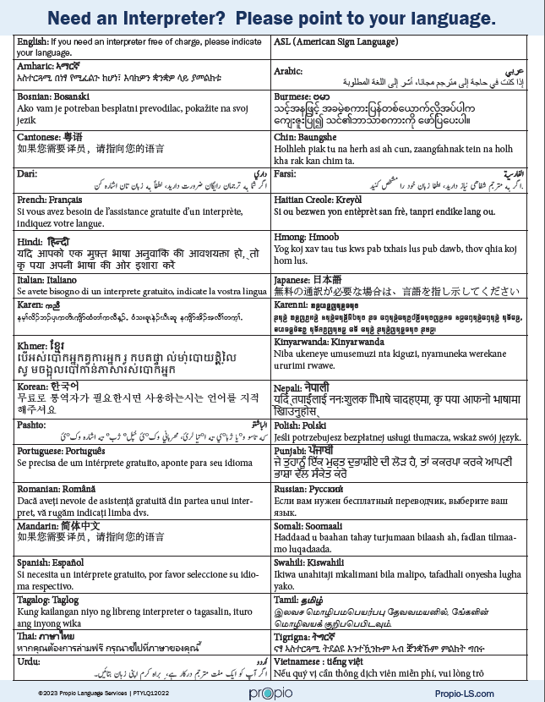
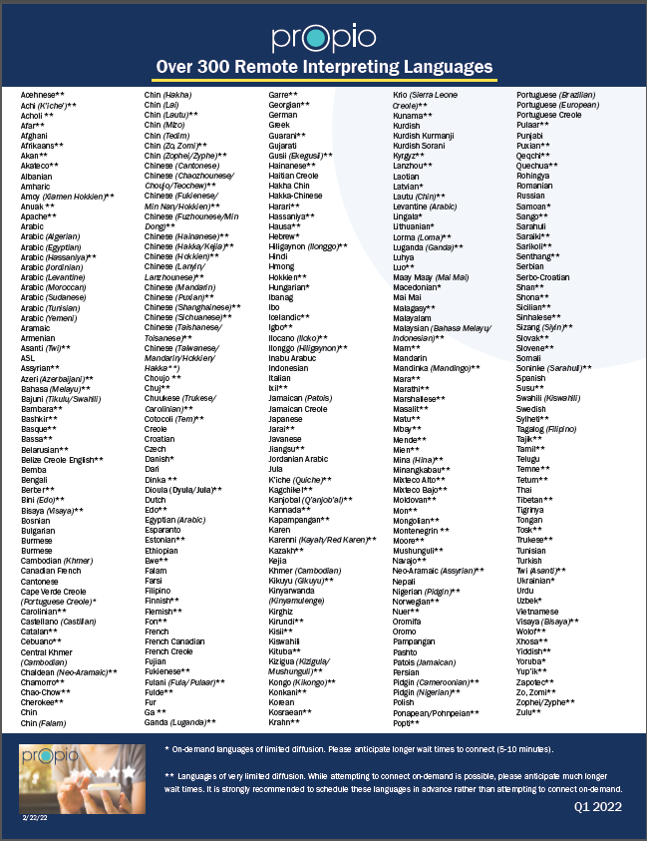
Notes:
I Speak references

Slide 15
Who can file a complaint?
According to the U.S. Department of Justice Office for Civil Rights (OCR):
Anyone that believes they have been discriminated against based on race, color, national origin, or disability, and in specific instances, age, sex (including sexual orientation and gender identity), or religion
A witness to discrimination
Anyone who has any connection between the protected activity and the adverse action
Notes:
How do they file a complaint? Title VI plan.

Slide 16
To File a Complaint:
Any person who believes they have been subjected to discrimination may file a written complaint with the City of Bismarck within 180 calendar days of the alleged incident.
Download complaint form from the City of Bismarck website (https://www.bismarcknd.gov/1413/Title-VI) or request the form from the Title VI Coordinator
Fill out all required information
Any complaint received must be forwarded to the Coordinator within 5 business days of receipt
The City of Bismarck will begin an investigation and will contact the Complainant in writing no later than 15 working days after receipt and they will be notified within 30 days if additional information is required to investigate the complaint. If the information is not provided in a timely manner, the City of Bismarck may administratively close the complaint
COB will use its best efforts to complete the investigation of Title VI and ADA complaints within 60 calendar days. A written report will be prepared by the investigator and sent to the complainant
At the conclusion of the investigation, the complainant and respondent will receive a letter of findings and determination or any applicable resolution

Slide 17
References
DEPARTMENT OF JUSTICE
Title Vl Of The Civil Rights Act Of 1964 42 U.S.C. 2000d Et Seq. (justice.gov)
US EQUAL EMPLOYMENT OPPORTUNITY COMMISSION
CM-604 Theories of Discrimination I U.S. Equal Employment Opportunity Commission (eeoc.gov)
NORTH DAKOTA DEPARTMENT OF TRANSPORTATION
NDDOT -Title Vl/Nondiscrimination and ADA Program
Notes:
A variety of references provided information for this training.

Slide 18
Questions/Discussion
HR Contact List
Leanne Schmidt, HR Director Title VI, Employee Relations | 355-1332
Brandi Morrison, HR Payroll Accountant Payroll Administration, Systems Projects & Maintenance | 355-1335
Breann Schauer, Senior HR Generalist Benefits, Employee Relations, Recruiting | 355-1337
Kaitlyn Duncan, HR Generalist Recruitment, Job Postings, Certification Lists | 355-1333
Teresa Myers, HR Payroll & Safety Generalist Payroll & System Administration, FMLA, WSI, Safety | 355-1334
Farren Eisenbeisz, HR Assistant General HR Questions, HR Portal, Personnel Actions & Projects | 355-1336

